Slide 1
Basic CPU

Slide 2
CPU Block Diagram
DATA BUS 8bit
A
B
IR
Control
Unit
AR
PC
RAM
256X8
ALU
ADDR BUS 8bit

Slide 3
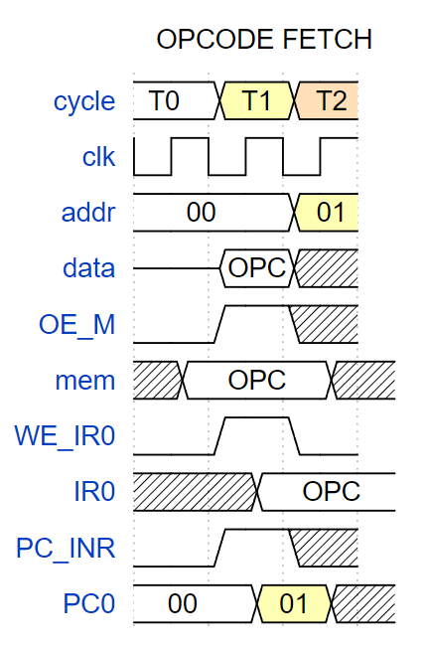
Instruction fetch

Slide 4
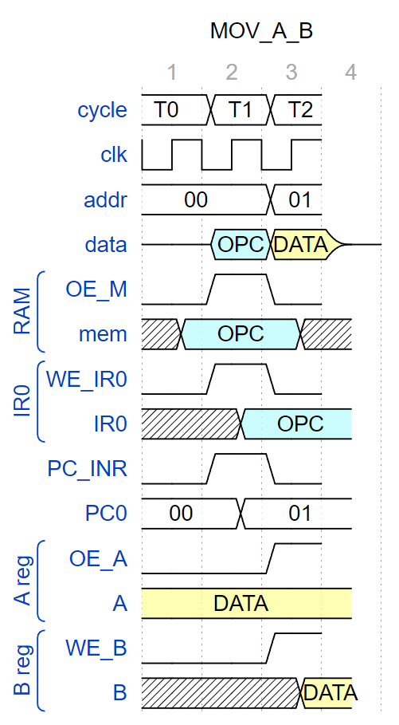
MOV_A_B

Slide 5
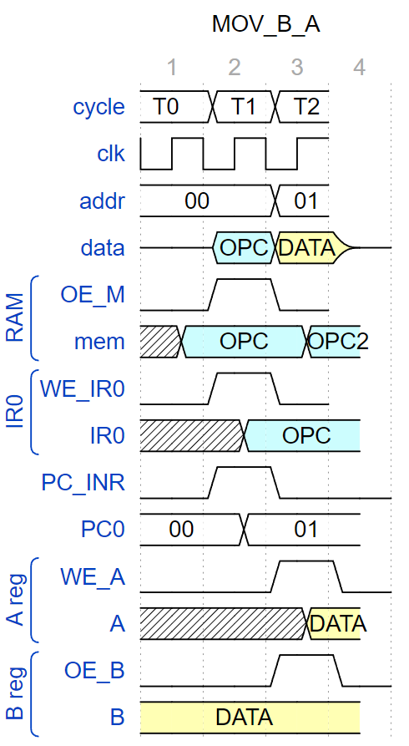
MOV_B_A

Slide 6
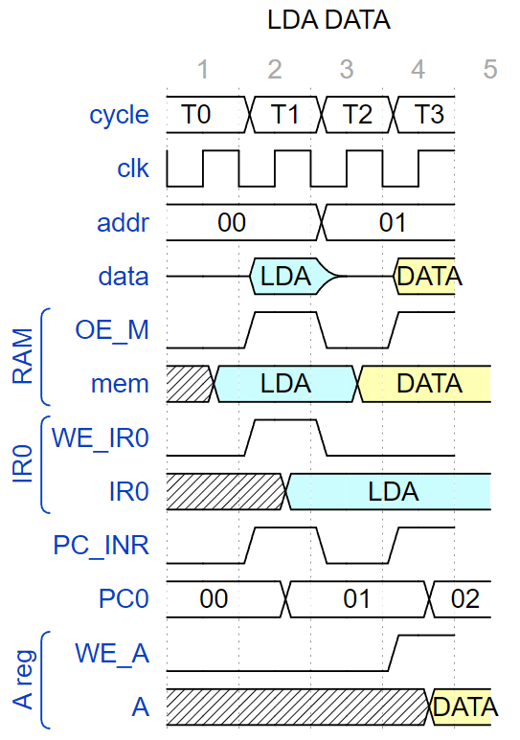
MVI

Slide 7
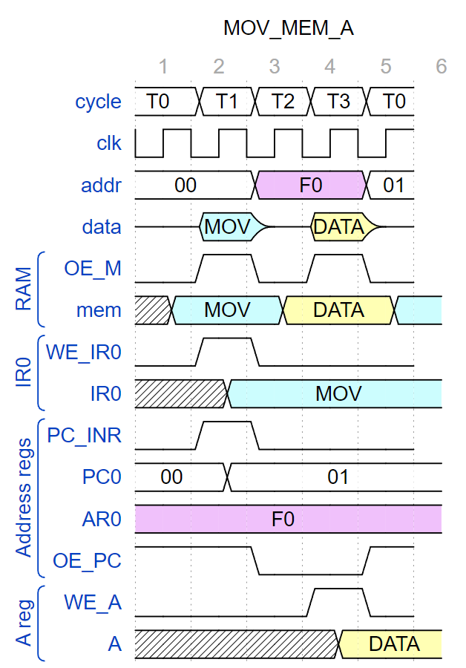
MOV_MEM_A: Memory Read

Slide 8
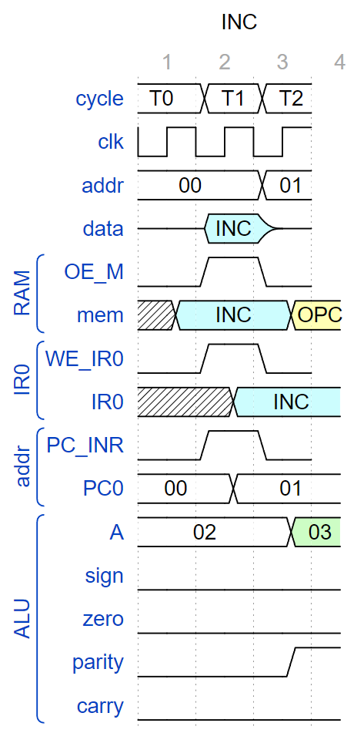
ALU:

Slide 9
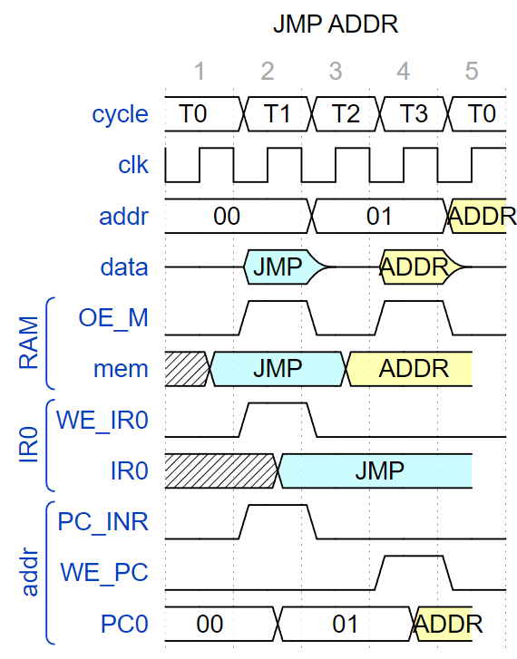
JMP UNCONDITIONAL:

Slide 10
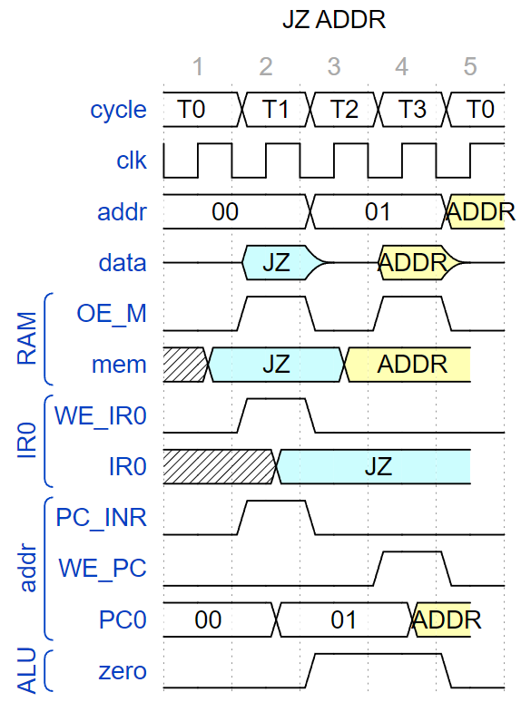
Conditional jump, pass:

Slide 11
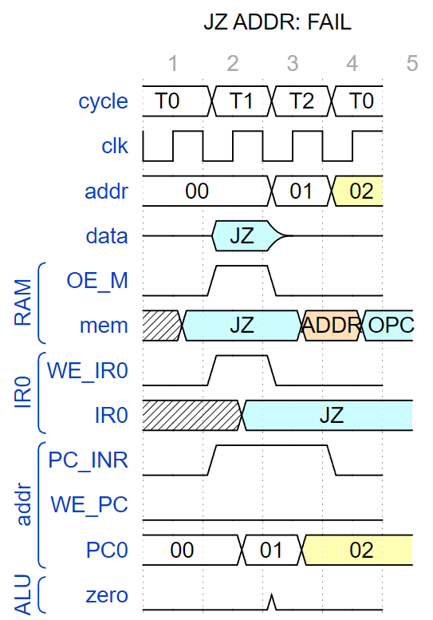
Conditional jump, fail:

Slide 12
RTL Table

Slide 13
CPU Block Diagram

Slide 14
ALU
A
B
IR
Control Unit
DATA BUS 8bit
AR
PC
ADDR BUS 8bit
RAM
256X8

Slide 15
DATA BUS 8bit
A
B
IR
Control
Unit
AR
PC
RAM
256X8
ALU
ADDR BUS 8bit

